Slide 1
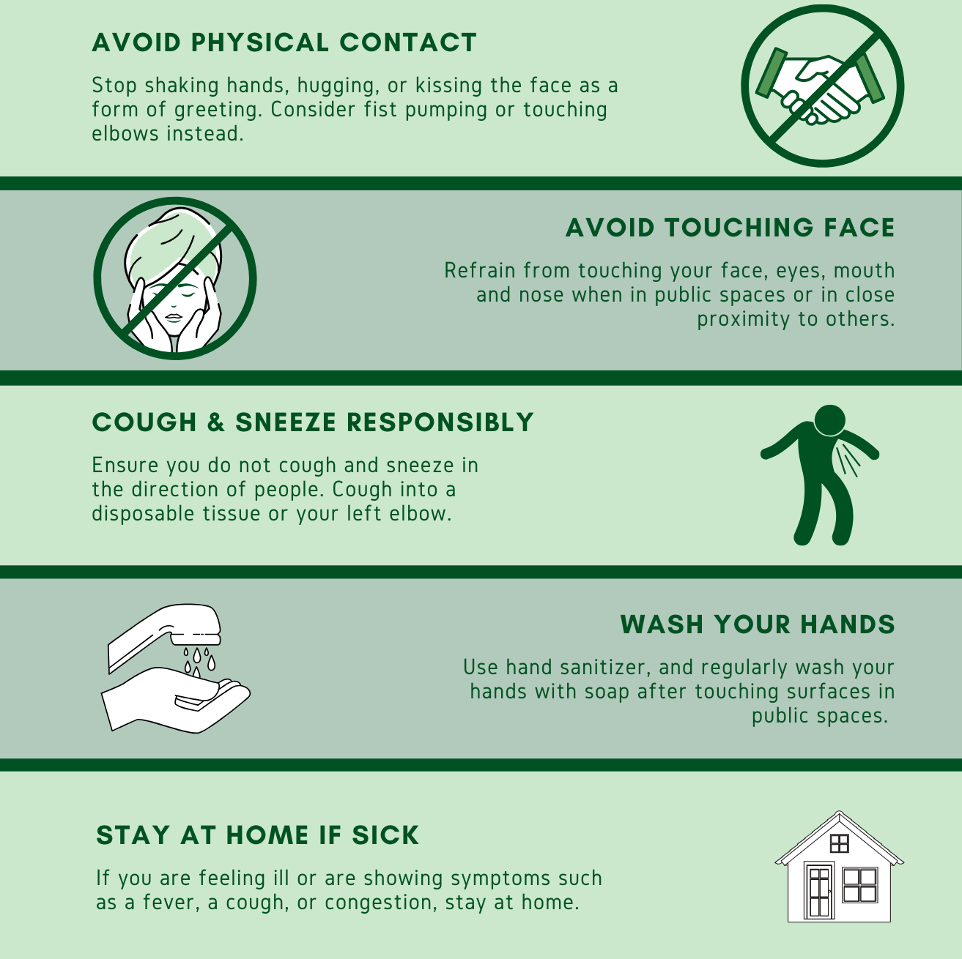
COVID-19
STOP THE SPREAD
For Founder Institute Events

